Slide 1
Viet Nam Charity Trip
September 12th to September 21nd 2022

Slide 2
Activities/Spending Summary
Lido Charity Corp Total Fund Raising in 2022 | $70,802.10
CA SI-100 (Statement of Information) Filling Fee | 20 | Every other year fee (SI Form)
Registry of Charitable Trust | 25 | Yearly renewal (RFR Form)
D&O Insurance | 1059.5 | Yearly Fee - D&O Insurance
Postage, Mailing, and Printing | 161.18 | Office Depot - Envelopes & Printing Paper - US Post Office 200 stamps
M&M Candies (50 lbs) | 577.5 | $398 candies & $179.50 shipping (Candies, MakeUps, and Clothes)
Huong Duong Orphanage - 09/14/2022 | 4,059 | 90 M&M bag of candy, 94,000,000.00 VN Dong donation, and 1,000,000 VN Dong for transportation
Benh Vien Giao Thong Van Tai TP Ho Chi Minh - Cataract Surgery Hospital - 09/15/2022 - Morning | 42,923 | 45,000,000.00 Dong for Su Co Phuc Duc for pre & post surgery cost. 960,000,000.00 Dong ($41,000.00) to Dr. Man Vo for surgery and hospital cost for 1,200 patients.
Te Phan Orphanage - 09/15/2022 - Afternoon | 5,273 | Total 81 children. 6M VN Dong for Pizza diner with the kids and 117.4M VN Dong donation.
Children Brain Tumor Hospital 2 - 09/19/2022 - Morning | 4,273 | Total 110 children. 500,000.00 VN Dong and M&M for each child. Funded 9 chemotherapy and radiation treatments at 5,000,000.00 each. Total 100M
Lam Quang Temple - 09/19/2022 - Afternoon | 1,784 | Total 150 old ladies, children, and volunteers. 6,750,000.00 VN Dong bake goods, and 35,000,000.00 VN Dong donation.
Ky Quang Temple - 09/20/2022 - Morning | 1,495 | Total 170 children.Candies for all children and 35,000,000.00 VN Dong donation.

Slide 3
Activities/Spending Summary – Cont.
Lido Charity Corp Total Fund Raising in 2022 | $70,802.10
Reading for the blind - 09/20/2022 - Afternoon | 512 | 12,000,000.00 VN Dong donation.
Soc Trang Blind Village - 09/21/2022 | 4,105 | Total 125 family. 600,000.00 VN Dong & a Box of noodle (71K) per family. 5,000,000.00 VN Dong donation to the temple that organizes the event, 2,200,000.00 VN Dong for the volunteers at the temple and 5,000,000.00 VN Dong for transportation
Lido Charity Corp Total Spending in 2022 | $66,267.00

Slide 4
Huong Duong Orphanage Center – Binh Duong – 09/14/2022 – Raising Children all the way to College

Slide 5
Huong Duong Orphanage Center – Binh Duong – 09/14/2022 – Lunch Time

Slide 6
Huong Duong Orphanage Center – Binh Duong – 09/14/2022 – Enjoying Candies

Slide 7
Huong Duong Orphanage Center – Binh Duong – 09/14/2022 – Donation Receipt

Slide 8
Cataract Surgery Hospital – 09/15/2022 - Morning

Slide 9
Cataract Surgery Hospital – 09/15/2022 – Patients waiting

Slide 10
Cataract Surgery Hospital – 09/15/2022 – Dr. Man Nguyen in Action

Slide 11
Cataract Surgery Hospital – 09/15/2022 – Look at the size of the cataract!

Slide 12
Cataract Surgery Hospital – 09/15/2022 – Donation Receipt

Slide 13
Cataract Surgery Hospital – 09/15/2022 – Donation Receipt (Su Co Phuc Duc)

Slide 14
Te-Phan Orphanage Center – 09/15/2022 – Evening - The kids were greeting us!

Slide 15
Te-Phan Orphanage Center – 09/15/2022 – Yummy Pizza Dinner w/the Kids

Slide 16
Te-Phan Orphanage Center – 09/15/2022 – Working hard to serve pizza ☺

Slide 17
Te-Phan Orphanage Center – 09/15/2022 – The kids were so happy to see us!

Slide 18
Te-Phan Orphanage Center – 09/15/2022 – Donation Receipt

Slide 19
Children Brain Tumor Hospital (110) – 09/19/2022 - Morning

Slide 20
Children Brain Tumor Hospital (110) – 09/19/2022 – Handling out $$ and Candy

Slide 21
Children Brain Tumor Hospital (110) – 09/19/2022

Slide 22
Children Brain Tumor Hospital (110) – 09/19/2022

Slide 23
Children Brain Tumor Hospital (110) – 09/19/2022

Slide 24
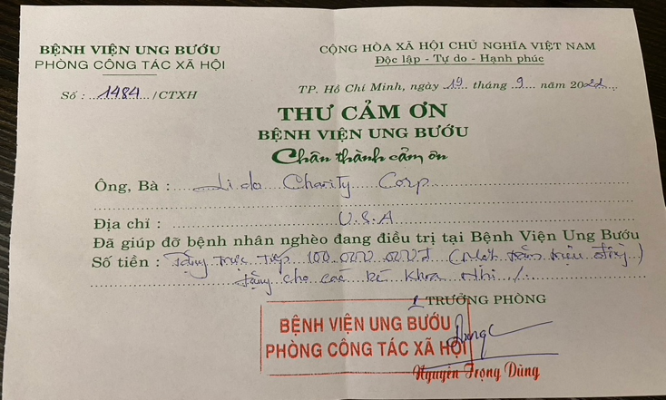
Children Brain Tumor Hospital (110) – 09/19/2022 – Donation Receipt

Slide 25
Lam Quang Temple – 10/19/2022 – Yummy Goodies for the Ladies (150)

Slide 26
Lam Quang Temple – 10/19/2022 – Housing 140+ Homeless & Famililess Ladies

Slide 27
Lam Quang Temple – 10/19/2022 – This Quarter Is For Very Sick Ladies

Slide 28
Lam Quang Temple – 10/19/2022 – With The Head of The Temple

Slide 29
Lam Quang Temple – 10/19/2022 – Goodies Receipt

Slide 30
Lam Quang Temple – 10/19/2022 – Donation Receipt

Slide 31
Ky Quang Temple – 09/20/2022 - Housing 170 Children Ranging from New Born to 17 Years Old

Slide 32
Ky Quang Temple – 09/20/2022 – Kids are having lunch

Slide 33
Ky Quang Temple – 09/20/2022 – Infants with Autism

Slide 34
Ky Quang Temple – 09/20/2022 – The Kids Were So Happy to Receive Candies

Slide 35
Ky Quang Temple – 09/20/2022 – Caring For Infants With Autism

Slide 36
Ky Quang Temple – 09/20/2022 – Donation Receipt

Slide 37
Reading For The Blind – 09/19/2022

Slide 38
Reading For The Blind – 09/19/2022 – The New Director Has Implemented Many New Initiatives For The Organization

Slide 39
Reading For The Blind – 09/19/2022 – A Typical Audio Studio – All Operated By Handicapped Workers

Slide 40
Reading For The Blind – 09/19/2022 - Activities

Slide 41
Reading For The Blind – 09/19/2022 – Donation Receipt

Slide 42
Soc Trang Blind Village – 09/21/2022 – 125 Families Gathering at Tinh Xa Ngoc Chau Nhu

Slide 43
Soc Trang Blind Village – 09/21/2022 – Head of Tinh Xa Giving Opening Speech

Slide 44
Soc Trang Blind Village – 09/21/2022 – 125 Families – Giving Out 600K & Box Of Noodle Per Family

Slide 45
Soc Trang Blind Village – 09/21/2022 – 125 Families – Giving Out Gift To The Volunteers

Slide 46
Soc Trang Blind Village – 09/21/2022 – 125 Families – Donation Receipt

Slide 47
Thank You for your continued support & generosity !!!

